Slide 1


Lab 1
Pytorch Basics
With PyTorch 0.2.0_2
Sung Kim <hunkim+ml@gmail.com>
Code: https://github.com/hunkim/DeepLearningZeroToAll/

Slide 2
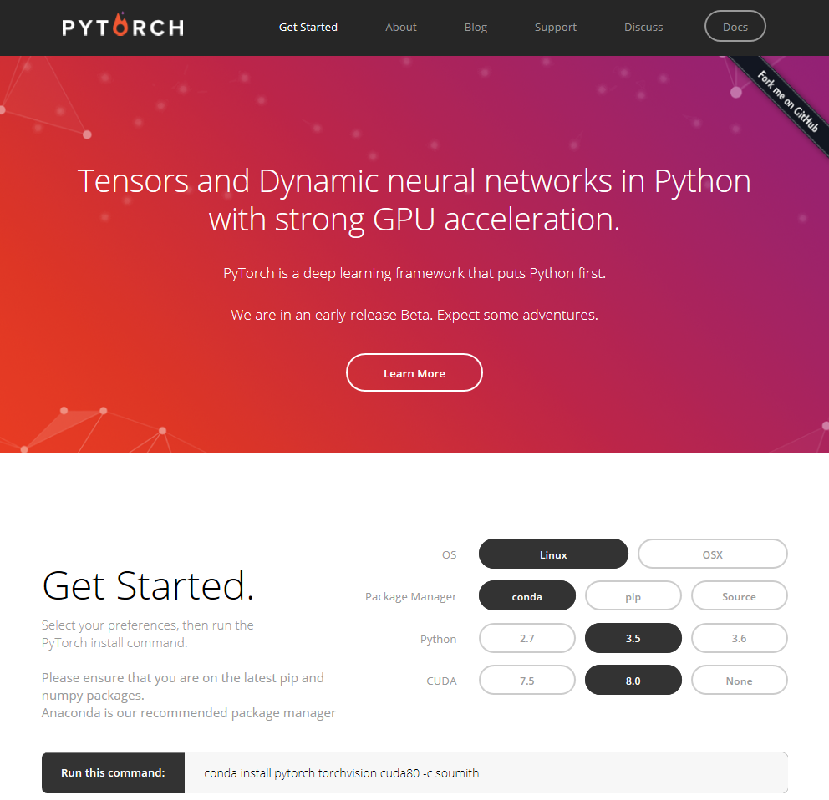
http://pytorch.org/

Slide 3

PYTORCH
Deep learning framework that puts Python first
Tensor Computation (like numpy) with strong GPU acceleration
http://pytorch.org/

Slide 4
PyTorch
http://pytorch.org/

Slide 5
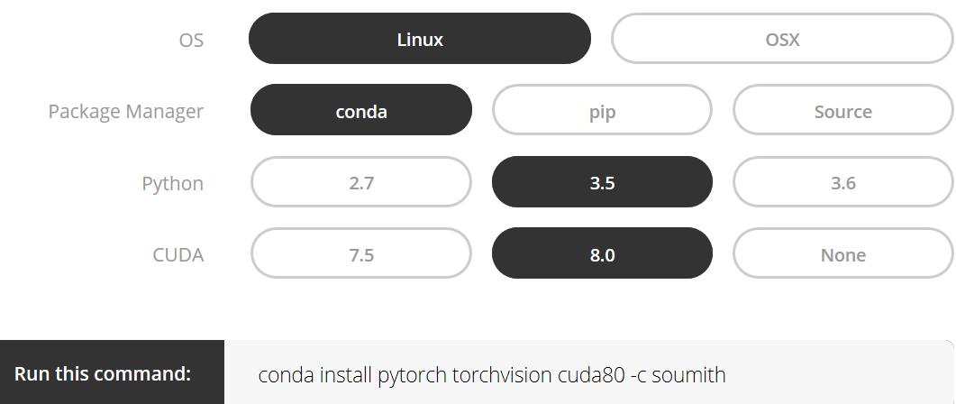
Installing PyTorch
On the latest pip and numpy packages
Anaconda is recommended package manager
http://pytorch.org/

Slide 6
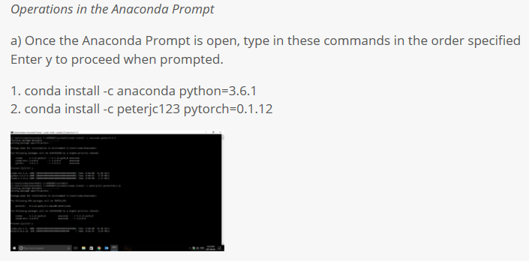
Installing PyTorch on windows
https://www.superdatascience.com/pytorch/

Slide 7
https://github.com/hunkim/DeepLearningZeroToAll/tree/master/pytorch
https://github.com/hunkim/PythonZeroToAll/blob/master/lab-01-1-pytorch_basics.ipynb

Slide 8
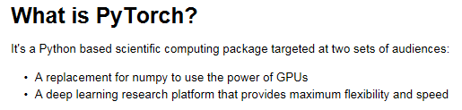
Hello PyTorch!
https://github.com/hunkim/PythonZeroToAll/blob/master/lab-01-1-pytorch_basics.ipynb

Slide 9
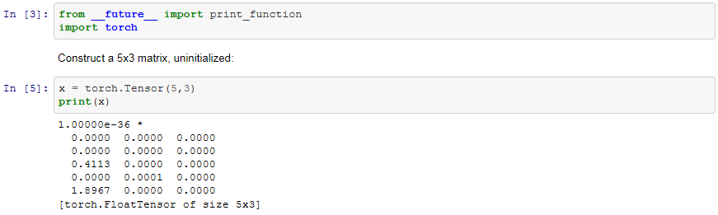
Tensors
Tensors are similar to numpy’s ndarrays, with the addition being that Tensors can also be used on a GPU to accelerate computing.
https://github.com/hunkim/DeepLearningZeroToAll/pytorch

Slide 10
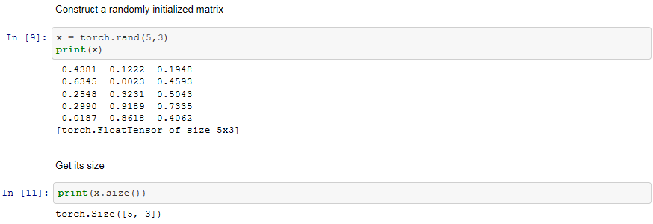
Tensors
Note: torch Size is in fact a tuple, so it supports the same operations.
https://github.com/hunkim/DeepLearningZeroToAll/pytorch

Slide 11
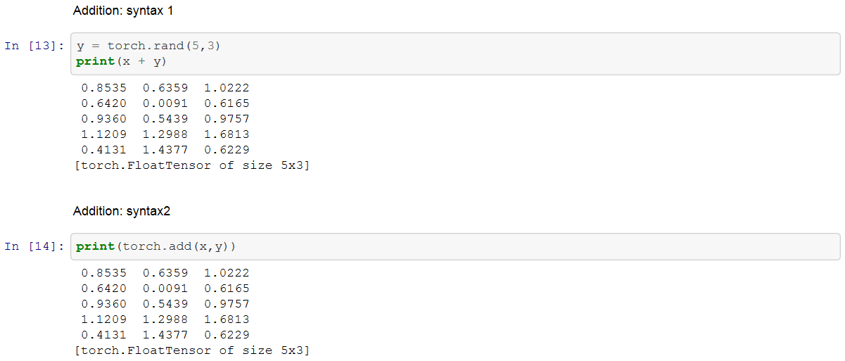
Operations
There are multiple syntaxes for operations. Let’s see addition as an example.
https://github.com/hunkim/DeepLearningZeroToAll/pytorch

Slide 12
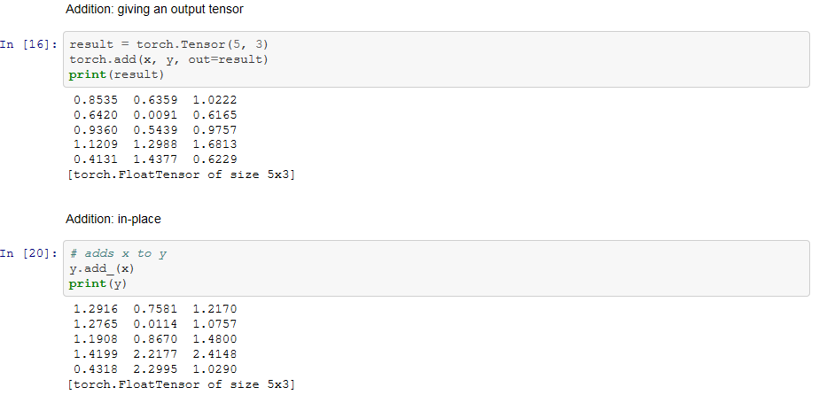
Operations
Note: Any operation that mutates a tensor in-place is post-fixed with an _.
For example, x.copy(y), x.t_(), will change x.
https://github.com/hunkim/DeepLearningZeroToAll/pytorch

Slide 13
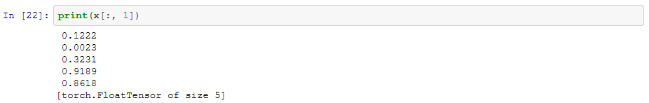
Operations
You can use standard numpy-like indexing with all bells and whistles!
Read later: 100+ Tensor operations, including transposing, indexing, slicing, mathematical operations, linear algebra, random numbers, etc are described here http://pytorch.org/docs/torch
https://github.com/hunkim/DeepLearningZeroToAll/pytorch

Slide 14
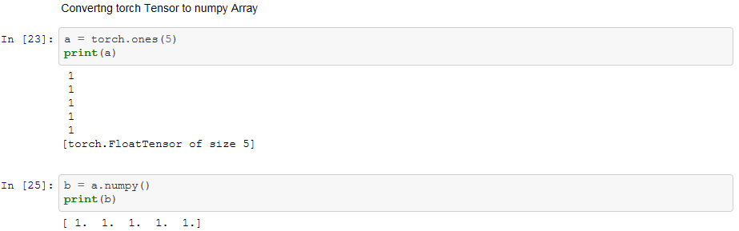
Numpy Bridge
Converting a torch Tensor to a numpy array and vice versa is a breeze.
The torch Tensor and numpy array will share their underlying memory locations, and changing one will change the other.
https://github.com/hunkim/DeepLearningZeroToAll/pytorch

Slide 15
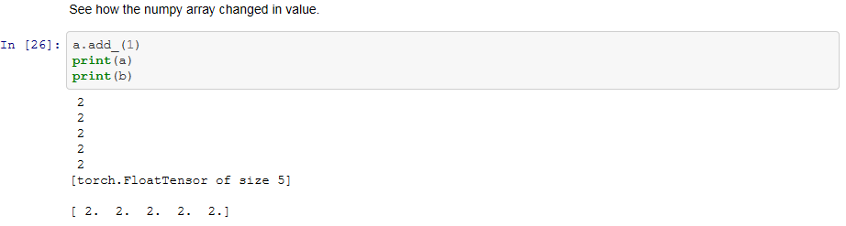
Numpy Bridge
https://github.com/hunkim/DeepLearningZeroToAll/pytorch

Slide 16
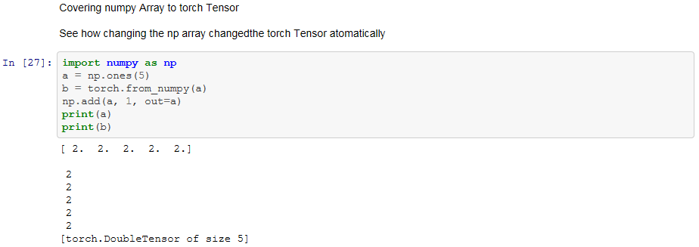
Numpy Bridge
All the Tensors on the CPU except a CharTensor support converting to Numpy and back.
https://github.com/hunkim/DeepLearningZeroToAll/pytorch

Slide 17
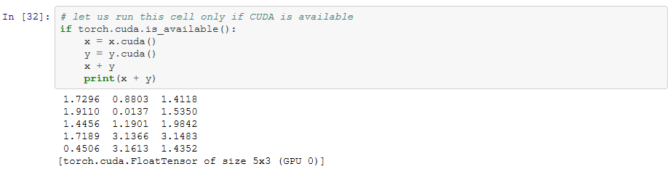
CUDA Tensors
Tensors can be moved onto GPU using the .cude function..
References: http://pytorch.org/tutorials/beginner/blitz/tensor_tutorial.html#tensors
https://github.com/hunkim/DeepLearningZeroToAll/pytorch

Slide 18
Lab 2
Linear Regression
With PyTorch 0.2.0_2
Sung Kim <hunkim+ml@gmail.com>

